Slide 1
Back Propagation Learning Algorithm
CO-2 Session 12

Slide 2



AIM
To familiarise students with the basic concept of Feed forward neural network based on Learning algorithms and to process of neural network in various Applications.
INSTRUCTIONAL OBJECTIVES
This unit is designed to:
Demonstrate Back Propagation overview
List out the activation functions of BPNN
Describe accuracy and loss functions
LEARNING OUTCOMES
At the end of this unit, you should be able to:
Define the functions BPNN algorithm
Summarise the development Back propagation neural network
Describe the various activation functions with loss values.

Slide 3
TOPICS TO BE COVERED
Back Propagation Overview
Back Propagation Algorithm
A Step By Step Back Propagation Example
Gradient Descent Rule
Delta learning Rule

Slide 4
What is Back propagation?
Backpropagation is an algorithm used in artificial intelligence (AI) to fine-tune mathematical weight functions and improve the accuracy of an artificial neural network's outputs. Backpropagation is the process of tuning a neural network's weights to better the prediction accuracy.
There are two directions in which information flows in a neural network. Forward propagation — also called inference — is when data goes into the neural network and out pops a prediction.
A neural network can be thought of as a group of connected input/output (I/O) nodes. The level of accuracy each node produces is expressed as a loss function (error rate).

Slide 5
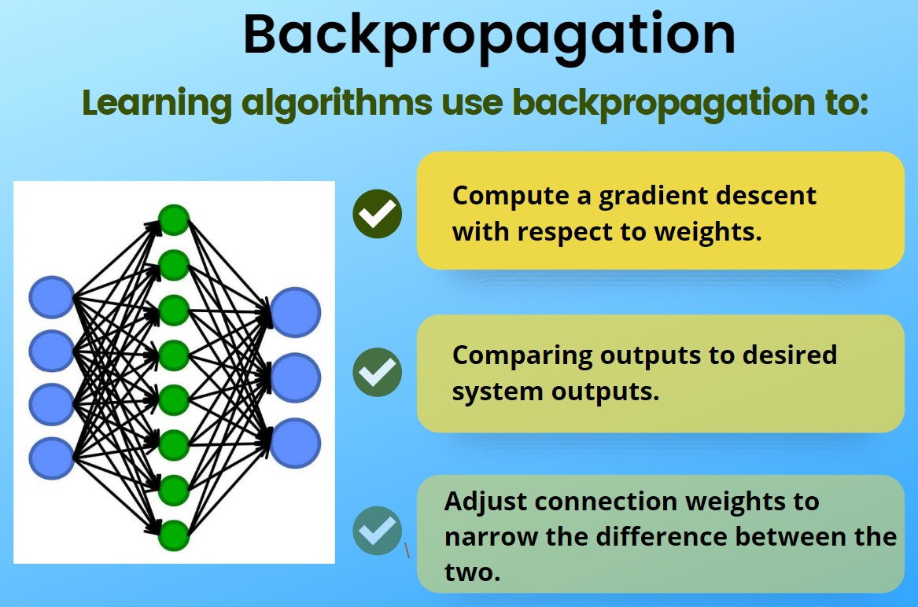
BACK PROPAGATION OVERVIEW
Backpropagation is the essence of neural network training. It is the method of fine-tuning the weights of a neural network based on the error rate obtained in the previous epoch (i.e., iteration). Proper tuning of the weights allows you to reduce error rates and make the model reliable by increasing its generalization.
Backpropagation in neural network is a short form for “backward propagation of errors.” It is a standard method of training artificial neural networks. This method helps calculate the gradient of a loss function with respect to all the weights in the network.
1
2
3

Slide 6
How Backpropagation Works: Simple Algorithm
Inputs X, arrive through the preconnected path
Input is modeled using real weights W. The weights are usually randomly selected.
Calculate the output for every neuron from the input layer, to the hidden layers, to the output layer.
Calculate the error in the outputs
Error_{B}= Actual Output – Desired Output
Travel back from the output layer to the hidden layer to adjust the weights such that the error is decreased.
Keep repeating the process until the desired output is achieved

Slide 7
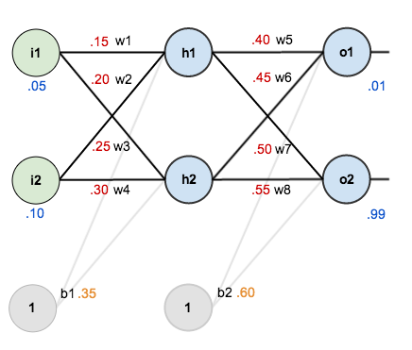
A Step by Step BACK PROPAGATION Example
1
2
3
The goal of backpropagation is to optimize the weights so that the neural network can learn how to correctly map arbitrary inputs to outputs.
To work with a single training set: given inputs 0.05 and 0.10, we want the neural network to output 0.01 and 0.99.

Slide 8

BACK PROPAGATION WORKING METHOD
Calculating the Total Error
We can now calculate the error for each output neuron using the squared error function and sum them to get the total error:
1
For example, the target output for I s 0.01 but the neural network output 0.75136507, therefore its error is:
2
3
Repeating this process for (r (remembering that the target is 0.99) we get:
The total error for the neural network is the sum of these errors:

Slide 9
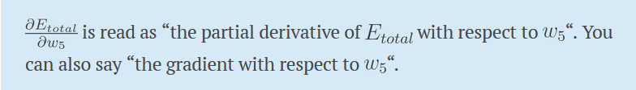
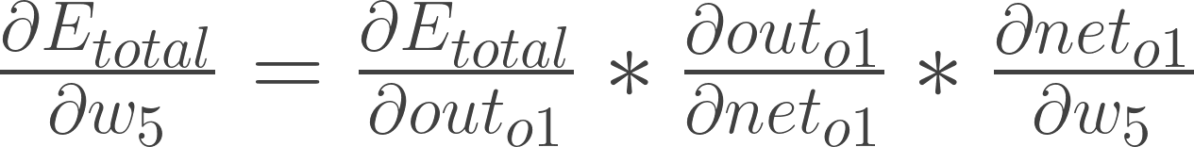
The Backwards Pass
Our goal with backpropagation is to update each of the weights in the network so that they cause the actual output to be closer the target output, thereby minimizing the error for each output neuron and the network as a whole.
Output Layer
1
Consider . we want to know how much a change in affects the total error, .
2
3
By applying the chain rule we know that:

Slide 10
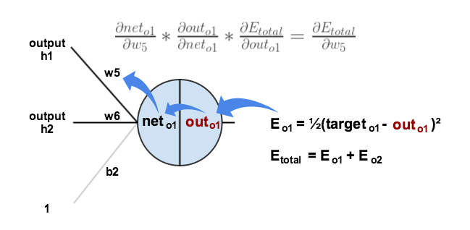
BACK PROPAGATION
1
2
3
We need to figure out each piece in this equation.
First, how much does the total error change with respect to the output?

Slide 11


BACK PROPAGATION
When we take the partial derivative of the total error with respect to , the quantity
becomes zero because does not affect it which means we’re taking the derivative of a constant which is zero.
Next, how much does the output of change with respect to its total net input?
The partial derivative of the logistic function is the output multiplied by 1 minus the output:
1
2
3
Finally, how much does the total net input of change with respect to ?

Slide 12
Putting it all together:
You’ll often see this calculation combined in the form of the delta rule:
The Delta rule in machine learning and neural network environments is a specific type of backpropagation that helps to refine connectionist ML/AI networks, making connections between inputs and outputs with layers of artificial neurons.
In general, backpropagation has to do with recalculating input weights for artificial neurons using a gradient method. Delta learning does this using the difference between a target activation and an actual obtained activation. Using a linear activation function, network connections are adjusted.
Another way to explain the Delta rule is that it uses an error function to perform gradient descent learning.

Slide 13
Apply the Delta rule
To decrease the error, we then subtract this value from the current weight (optionally multiplied by some learning rate, eta, which we’ll set to 0.5):

Slide 14
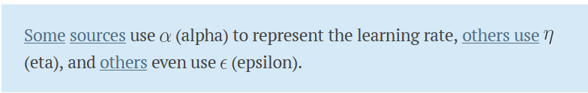

We can repeat this process to get the new weights , , and :

Slide 15
Web References
[1] https://www.guru99.com/backpropogation-neural-network.html
[2] https://mattmazur.com/2015/03/17/a-step-by-step-backpropagation-example/
[3] http://neuralnetworksanddeeplearning.com/chap2.html

Slide 16
Self-Assessment Questions
What do the gradients of backpropagation compute?
Profit Function
Loss function
Negative Function
Positive Function
Which rule is followed by the Backpropagation algorithm?
Static Rule
Dynamic Rule
Chain Rule
None

Slide 17

THANK YOU
OUR TEAM

